Slide 1




Deep Learning Methods for Unsupervised Time-Series Anomaly Detection
iSMART Lab
Narges Armanfard, Professor
Thi Kieu Khanh Ho, PhD Candidate
Hadi Hojjati, PhD Candidate
McGill University
Mila - Quebec AI Institute
Montreal, QC, Canada
Website: ismart.ece.mcgill.ca
iSMART Lab – AAAI 24
1

Slide 2
Outline
iSMART Lab
In This Tutorial:
What is time-series anomaly detection (TSAD)?
How does TSAD differ from other Anomaly detection tasks?
Why deep learning is suitable for this problem?
Current issues in deep learning for TSAD!
Two SOTA approaches:
Graph Neural Networks
Self-Supervised Learning
iSMART Lab – AAAI 24
2

Slide 3
Introduction
iSMART Lab
iSMART Lab – AAAI 24
3

Slide 4
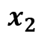
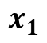
What is an Anomaly?
iSMART Lab
(Based on the previous works): Anomaly Detection (AD) is the process of identifying samples that significantly deviate from the rest of the data.
Signals a potential malfunction/threat
Rare occurrence
Irregular
This definition is independent of the application and the data type.
$$x_{2}$$
$$x_{1}$$
iSMART Lab – AAAI 24
4

Slide 5
Time Series Anomaly Detection: Definition
iSMART Lab
A time-series is a collection of observations made over a continuous period of time, with each observation associated with a specific timestamp or time interval.
Defining Anomalies in time series is an extremely challenging task!
Different ways of defining what is a deviation!
Depends on the application
Noise VS Anomaly
The definition can change over time
2. What should the algorithm predict as the output?
Binary output (0/1)
Anomaly score as the output
iSMART Lab – AAAI 24
5

Slide 6
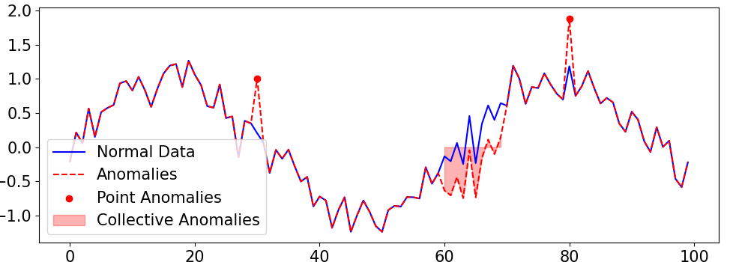
Time Series Anomaly Detection: Definition
iSMART Lab
Defining Anomalies in time series is an extremely challenging task!
3. Unseen anomaly classes
A new pattern or class might be observed should the model identify it as normal or abnormal.
4. Different anomaly types
Point Anomaly/Collective Anomaly/Trend Anomaly/etc.
Some types of anomalies could be of more interest in a specific application
iSMART Lab – AAAI 24
6

Slide 7
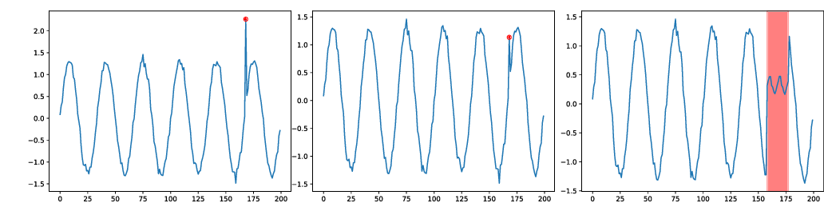
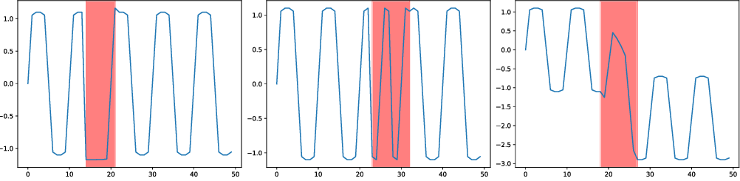
Types of Anomalies in Time-Series
iSMART Lab
Lai et al., Revisiting Time Series Outlier Detection: Definitions and Benchmarks, NeurIPS 2021
iSMART Lab – AAAI 24
7

Slide 8





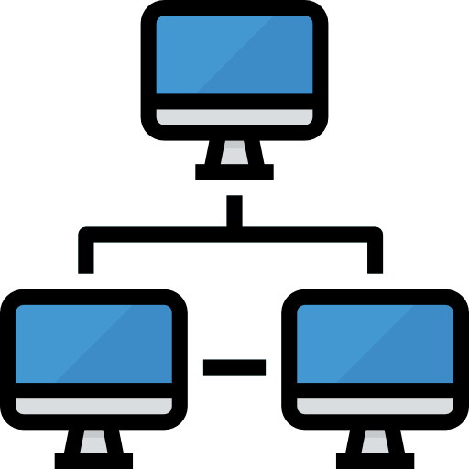




Application
iSMART Lab
Vehicles
Video
Healthcare
Manufacturing
Finance
Predictive maintenance, detect battery charging issues in EV
Detecting abnormal/rare activities or events
Detect events from RFID, mobiles and wearable devices
Detecting abnormal machine behavior to prevent costs
Detect fraudulent transactions/Identify cyber intrusions
Cybersecurity
Telecom
Astronomy
Social Media
Smart Homes
Detecting intrusion into networks, prevent theft of source code
Detect roaming abuse, revenue fraud, service disruption
Detect abnormal astronomical events and cosmic explosions
Detect compromised accounts, bots that generate fake news
Detect energy leakage, detect fatal health conditions and threats
iSMART Lab – AAAI 24
8

Slide 9
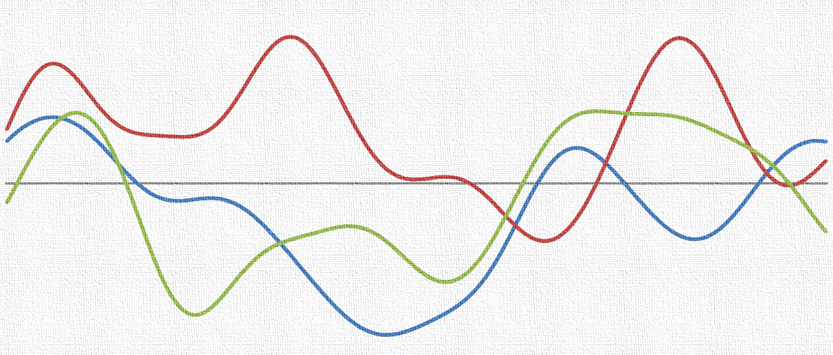
Traditional (Shallow) Methods
iSMART Lab
Input Data
- (One-Class) SVM
- Random Forest
- Isolation Forest
- DBSCAN
- GMM
- KDE
- Clustering, PCA, Graph, etc
Feature
Construction
Anomaly Detector
iSMART Lab – AAAI 24
9

Slide 10
Traditional (Shallow) Methods - Challenges
iSMART Lab
- Requirement for handcrafting features and algorithms
These models often fail on raw data and require feature engineering
- Curse of Dimensionality
Time series often consist of recordings from multiple sensors/sources
- Scalability
The number of features and input data affects the complexity of the model
iSMART Lab – AAAI 24
10

Slide 11
Deep Learning and TSAD: A Tale of Triumph and Turmoil
iSMART Lab
iSMART Lab – AAAI 24
11

Slide 12
Deep Learning for TSAD
iSMART Lab
Hierarchical Feature Learning
Deep models can automatically learn hierarchical representations of features.
Capturing Complex Patterns
They are capable of capturing and modelling non-linear relationships.
Temporal Abstraction
Some deep models like RNNs are designed to capture temporal dependencies.
Adaption to New Data
Allows leveraging knowledge gained from one domain to improve
Robustness to Noise
Deep learning models are often robust to noise
iSMART Lab – AAAI 24
12

Slide 13
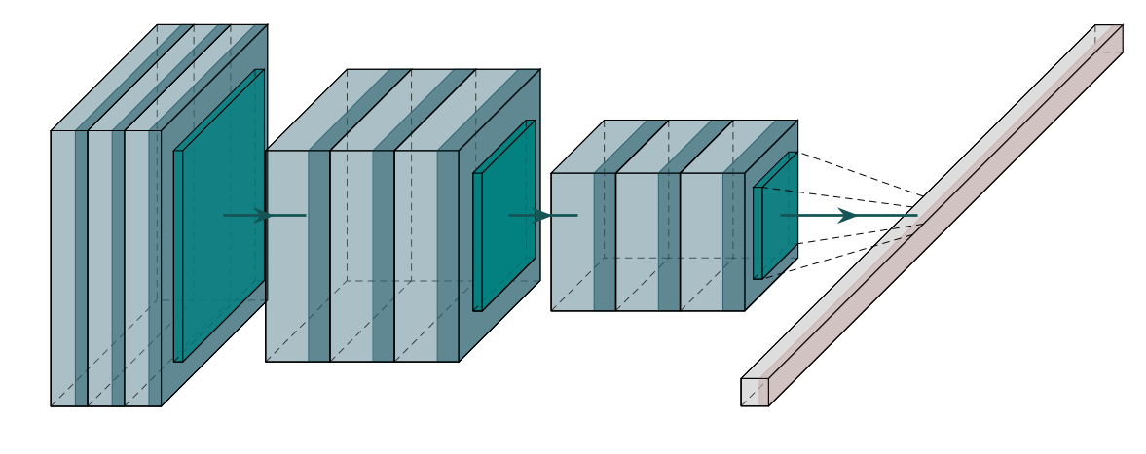
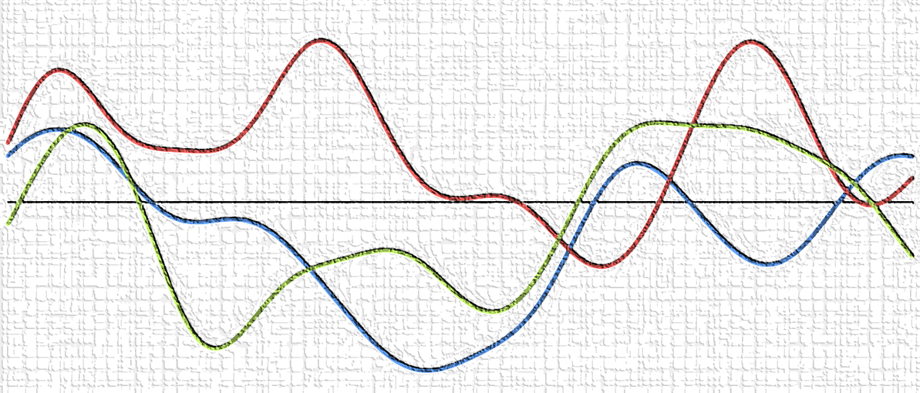
Deep Learning for TSAD
iSMART Lab
Segmentation
Raw Anomaly Score
Input
Filtering the Score
Label Adjustment
Evaluation
Label Assignment
Thresholding
iSMART Lab – AAAI 24
13

Slide 14
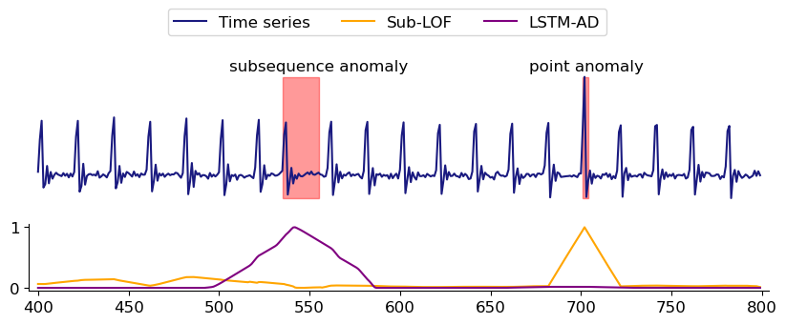
Researchers’ Playground: Handpicking Datasets
iSMART Lab
The type of anomaly does matter in algorithm performance!
seasonal anomaly
Sub-LOF: Simple algorithm/ detects the point anomaly very well
LSTM-AD: Complex algorithm/ detects subsequence anomaly
A wide range of datasets should be used for evaluation!
Schmidl et al., Anomaly Detection in Time Series: A Comprehensive Evaluation, VLDB 2022
iSMART Lab – AAAI 24
14

Slide 15
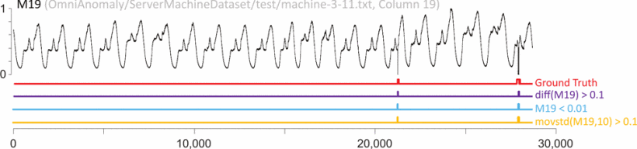
Researchers’ Playground: Inappropriate Benchmarks
iSMART Lab
Too Easy to Solve!
A one-line code can solve it!
Wu and Keogh, Current Time Series Anomaly Detection Benchmarks are Flawed and are Creating the Illusion of Progress, ICDE 2022
iSMART Lab – AAAI 24
15

Slide 16
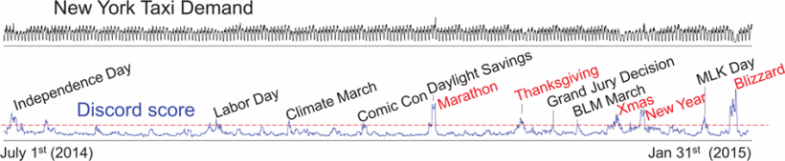
Researchers’ Playground: Inappropriate Benchmarks
iSMART Lab
Subjective Labelling
In many instances, it is impossible to define the true label for each data point!
Wu and Keogh, Current Time Series Anomaly Detection Benchmarks are Flawed and are Creating the Illusion of Progress, ICDE 2022
iSMART Lab – AAAI 24
16

Slide 17
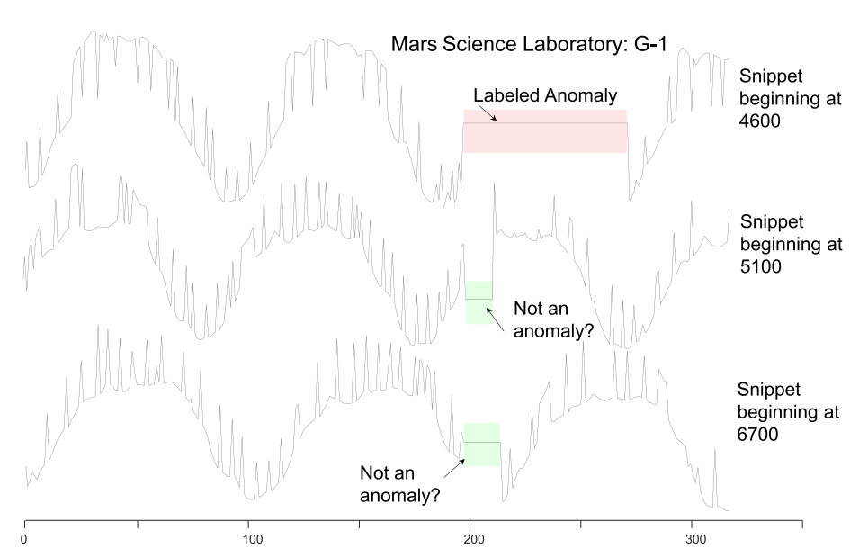
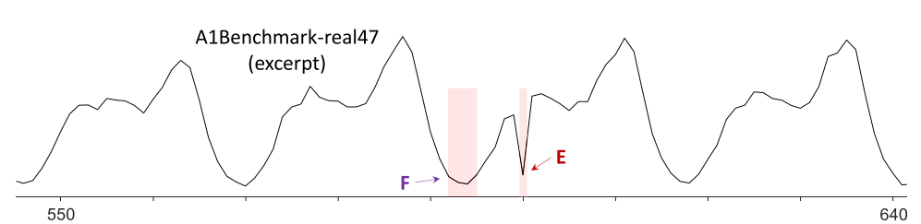
Researchers’ Playground: Inappropriate Benchmarks
iSMART Lab
Subjective Labelling
Wu and Keogh, Current Time Series Anomaly Detection Benchmarks are Flawed and are Creating the Illusion of Progress, ICDE 2022
iSMART Lab – AAAI 24
17

Slide 18
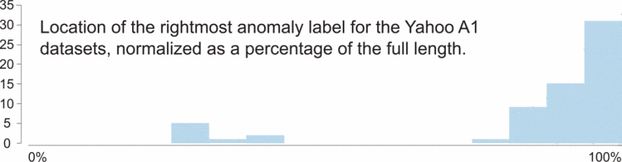
Researchers’ Playground: Inappropriate Benchmarks
iSMART Lab
Run to Failure Bias
Most anomalies appear at the end of the time-series
A naïve algorithm that simply labels the last point as an anomaly has an excellent chance of being correct!
Wu and Keogh, Current Time Series Anomaly Detection Benchmarks are Flawed and are Creating the Illusion of Progress, ICDE 2022
iSMART Lab – AAAI 24
18

Slide 19
Researchers’ Playground: Inappropriate Benchmarks
iSMART Lab
Inappropriate Benchmark Datasets
Many published comparisons of anomaly detection algorithms may be unreliable!
iSMART Lab – AAAI 24
19

Slide 20
Deep Learning for TSAD
iSMART Lab
Segmentation
Raw Anomaly Score
Input
Filtering the Score
Label Adjustment
Evaluation
Label Assignment
Thresholding
iSMART Lab – AAAI 24
20

Slide 21
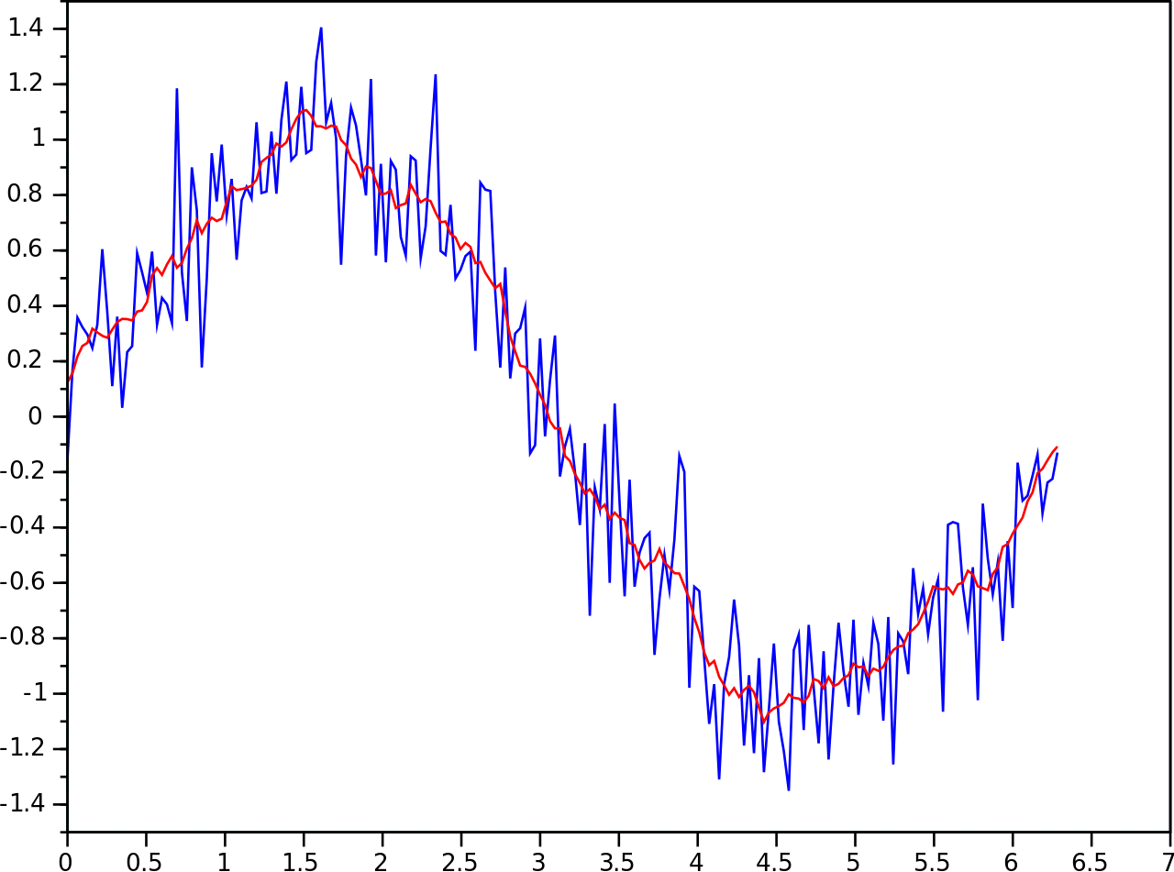
Researchers’ Playground: Filtering the Anomaly Score
iSMART Lab
The raw output of neural network is noisy and does not consider the temporal dependencies
We can use a kernel, aka scoring function, to filter and smoothen the anomaly score
Many researchers incorporate this step as one module of their algorithm
iSMART Lab – AAAI 24
21

Slide 22
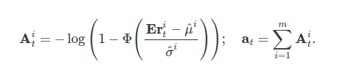
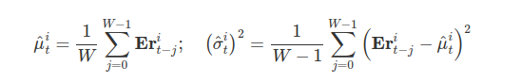
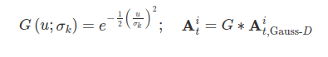
Researchers’ Playground: Filtering the Anomaly Score
iSMART Lab
Gauss-S
Gauss-D
Gauss-D-K
Kim et al., Towards a Rigorous Evaluation of Time-Series Anomaly Detection, AAAI 2022
iSMART Lab – AAAI 24
22

Slide 23
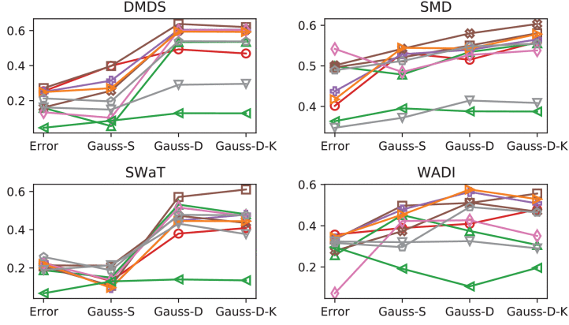
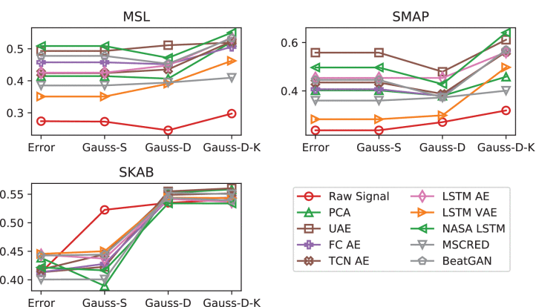
Researchers’ Playground: Filtering the Anomaly Score
iSMART Lab
Common TSAD Benchmark datasets: SWAT/WADI/MSL/SMAP/SKAP/SMD/DMDS
Simple Dataset
Garg et al., An Evaluation of Anomaly Detection and Diagnosis in Multivariate Time Series, TNNLS 2022
iSMART Lab – AAAI 24
23

Slide 24
Deep Learning for TSAD
iSMART Lab
Segmentation
Raw Anomaly Score
Input
Filtering the Score
Label Adjustment
Evaluation
Label Assignment
Thresholding
iSMART Lab – AAAI 24
24

Slide 25


Labelling is easy in CV but not in TS!
iSMART Lab
How should we evaluate the model’s output?
Normal (Dog): 99.7%
Abnormal (Cat): 0.3%
Good Classifier
In Time-Series, it is not as straightforward!
iSMART Lab – AAAI 24
25

Slide 26
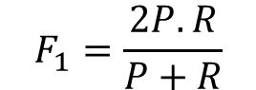
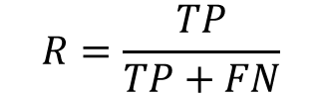
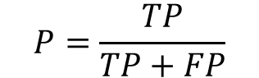
Researchers’ Playground: Label Adjustment
iSMART Lab
The anomaly score is often defined for each time-step
F1 can be used to evaluate the performance
$$P=\frac{TP}{TP+FP}$$
$$R=\frac{TP}{TP+FN}$$
$$F_{1}=\frac{2P.R}{P+R}$$
We cannot expect the model to detect the label of every single timestamp!
Even one alarm might be enough!
iSMART Lab – AAAI 24
26

Slide 27
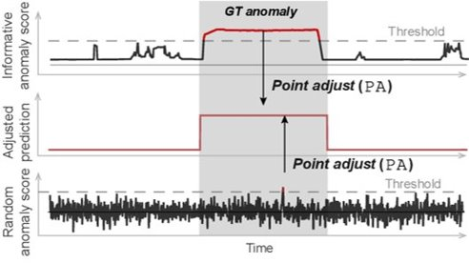
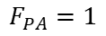
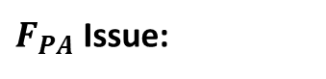
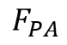
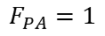
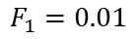
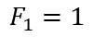
Researchers’ Playground: Label Adjustment
iSMART Lab
Point Adjustment: Even if the model detects one anomaly in the segment, label the rest of the segment as anomaly and then find F1
$$F_{PA}$$
$F_{PA}$ Issue:
$$F_{1}=1$$
$$F_{PA}=1$$
$$F_{1}=0.01$$
$$F_{PA}=1$$
Kim et al., Towards a Rigorous Evaluation of Time-Series Anomaly Detection, AAAI 2022
iSMART Lab – AAAI 24
27

Slide 28
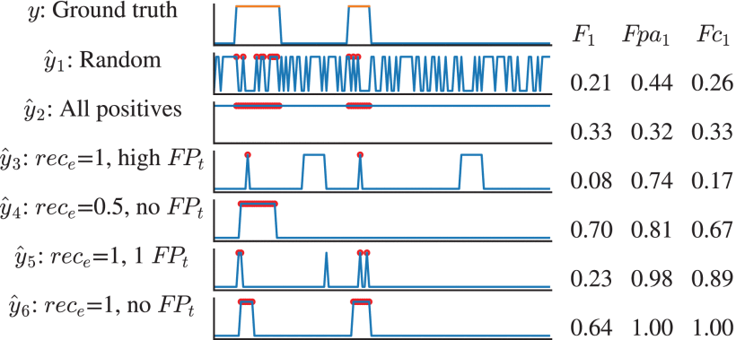
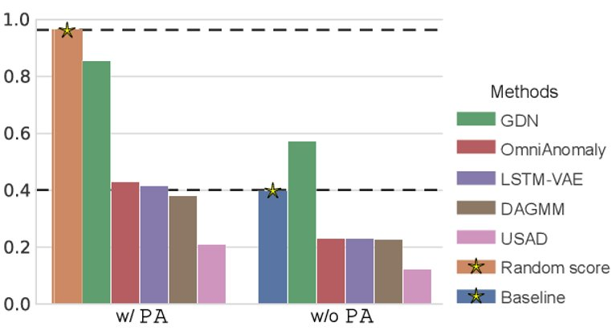
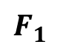
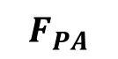
Researchers’ Playground: Label Adjustment
iSMART Lab
$$F_{1}$$
$$F_{PA}$$
0.91
Garg et al., An Evaluation of Anomaly Detection and Diagnosis in Multivariate Time Series, TNNLS 2022
iSMART Lab – AAAI 24
28

Slide 29
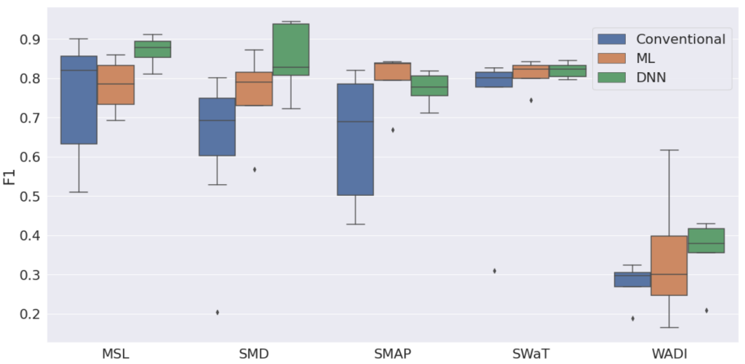
Is Deep Learning the best solution for TSAD?
iSMART Lab
Compare 16 conventional, non-deep (ML) and, deep neural network approaches on 5 real-world open simple datasets (SWaT, WADI, SMD, SMAP, MSL).
No significant evidence of DL methods outperforming the others!
Audibert et al. “Do Deep Neural Networks Contribute to Multivariate Time Series Anomaly Detection?”, Pattern Recognition, 2022
iSMART Lab – AAAI 24
29

Slide 30
The Way Forward
iSMART Lab
A unique opportunity for researchers!
Deep Learning is still an attractive option for TSAD
Learning from mistakes:
We need new benchmark datasets!
Comparing the performance with simple, trivial, and even random baselines
Filtering function should be uniform across all baselines
Purely numerical results are not the goal!
No free lunch! Each application requires its own method of design
iSMART Lab – AAAI 24
30

Slide 31
Deep Learning and TSAD: State of The Art
iSMART Lab
iSMART Lab – AAAI 24
31

Slide 32
Graph-Based TSAD
iSMART Lab
Why Graphs?
Deng and Hoi, Graph Neural Network-Based Anomaly Detection in Multivariate Time Series, AAAI 2021
Kim et al., Towards a Rigorous Evaluation of Time-Series Anomaly Detection, AAAI 2022
iSMART Lab – AAAI 24
32

Slide 33

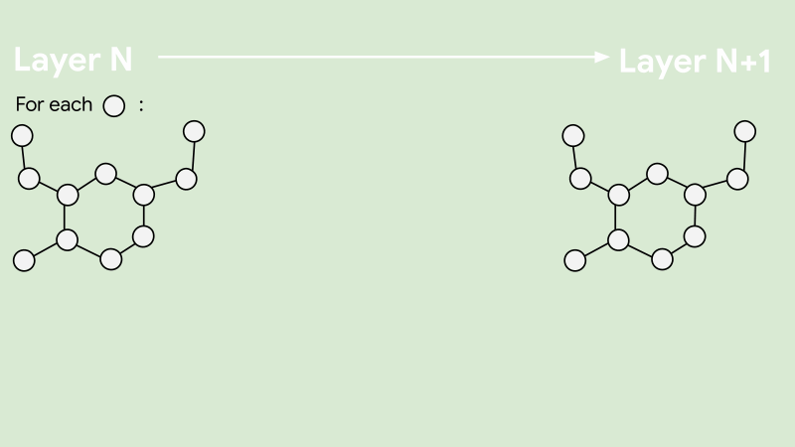
Graph-Based TSAD
iSMART Lab
Each Sensor/Source is modeled as a node
Source: Google AI Blog
iSMART Lab – AAAI 24
33

Slide 34
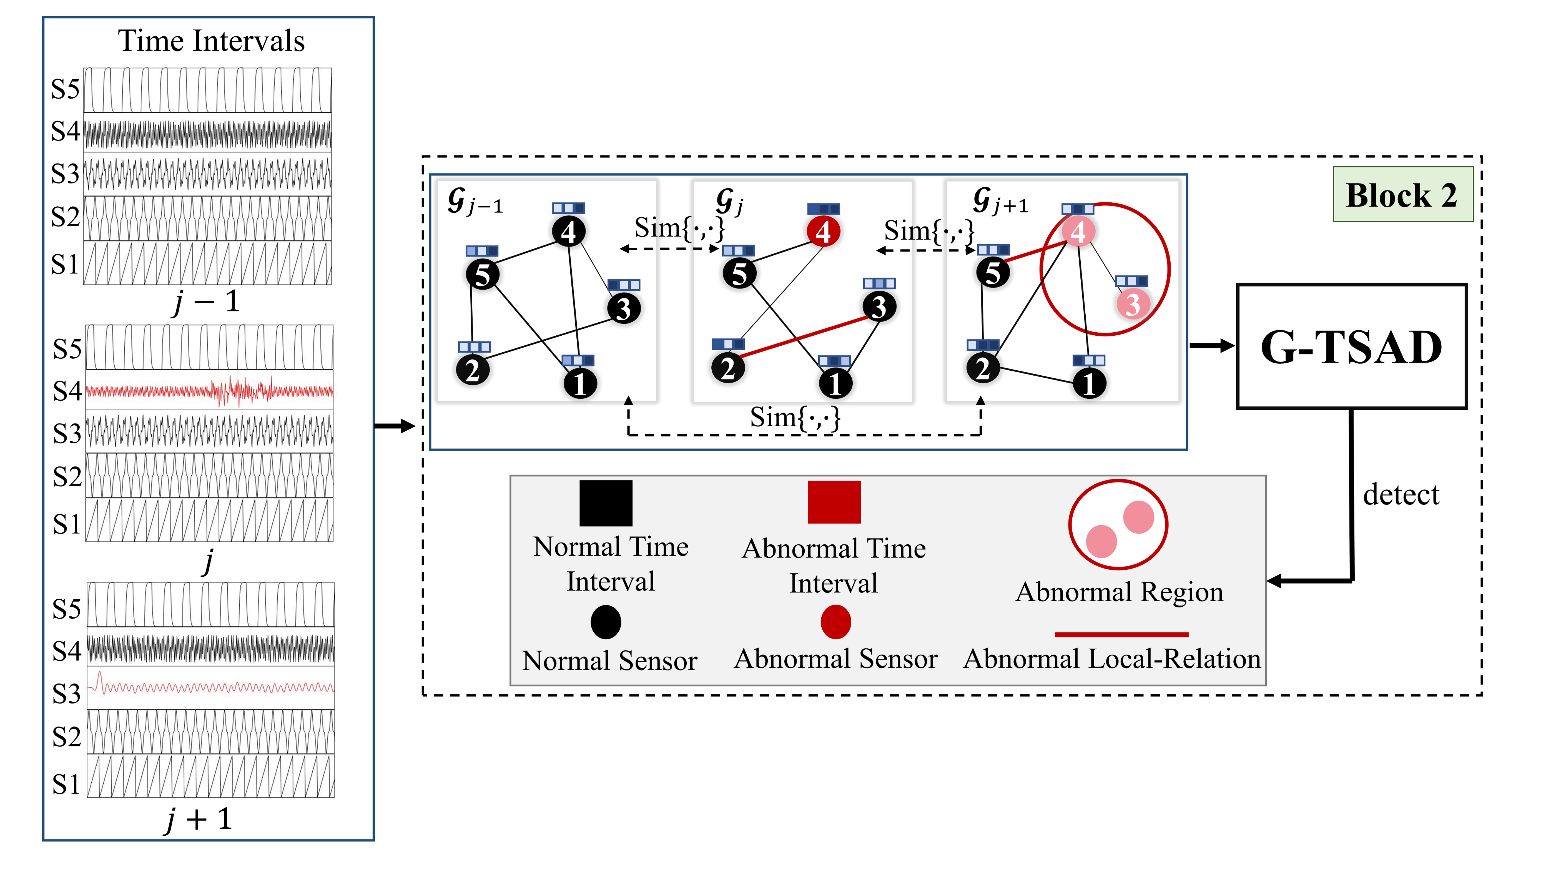
Graph-Based TSAD
iSMART Lab
Graph-Based methods are extremely relevant for deep TSAD!
TKK Ho, A Karami, N Armanfard, Graph-based Time-Series Anomaly Detection: A Survey and Outlook.
iSMART Lab – AAAI 24
34

Slide 35
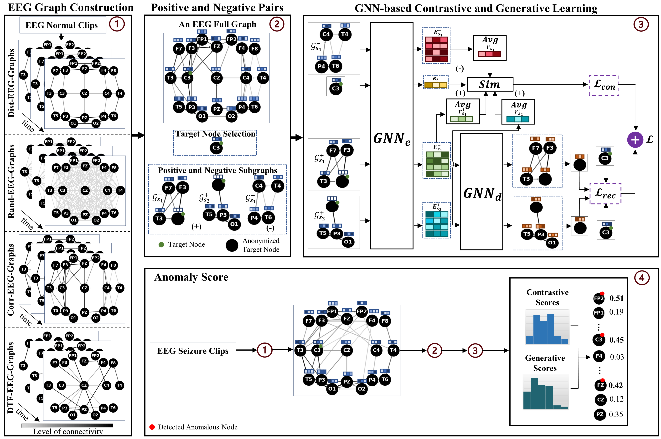
TSAD in EEG Data with Graphs
iSMART Lab
In some cases, unsupervised graph-based methods can outperform binary classifiers!
TKK Ho, N Armanfard, Self-supervised Learning for Anomalous Channel Detection in EEG Graphs: Application to Seizure Analysis, AAAI-23 (Oral)
Your Name
35
iSMART Lab
35
iSMART Lab – AAAI 24
Notes:
Have 2-3 for each algorithm

Slide 36
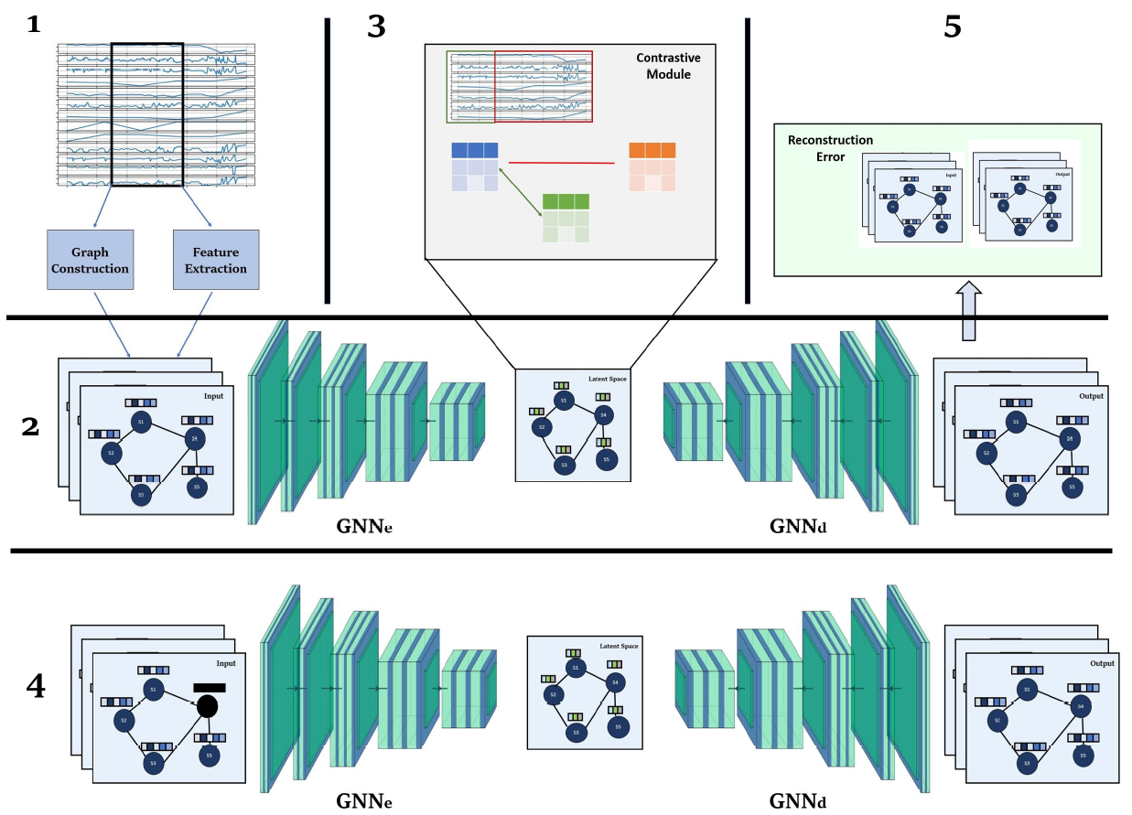
Graph-Based Methods for Vehicle Data
iSMART Lab
H. Hojjati, M. Sadeghi, N Armanfard, Multivariate Time-Series Anomaly Detection with Temporal Self-Supervision and Graphs: Application to Vehicle Failure Prediction, ECML PKDD 2023
Your Name
36
iSMART Lab
36
iSMART Lab – AAAI 24
Notes:
Talk about the fact that we do them on real data

Slide 37

Self-Supervised Contrastive Learning
iSMART Lab
A good representation of data can facilitate anomaly detection!
Self-Supervised Methods have established themselves as SOTA in image anomaly detection
Defining a meaningful augmentation set/proxy task is challenging for time-series
Source: Google AI Blog
37
iSMART Lab – AAAI 24
37
Notes:
Talk about the fact that we do them on real data

Slide 38
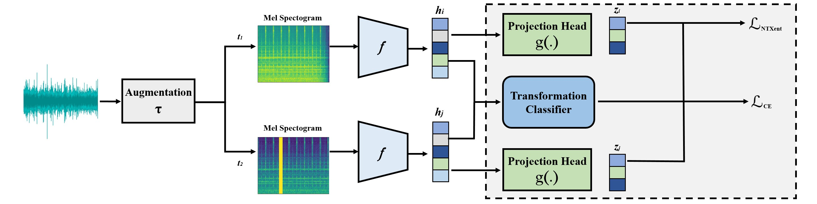
Contrastive Learning for Acoustic AD
iSMART Lab
H. Hojjati, N Armanfard, Self-Supervised Acoustic Anomaly Detection via Contrastive Learning, ICASSP 2022
38
iSMART Lab
38
iSMART Lab – AAAI 24
Notes:
Talk about the fact that we do them on real data

Slide 39

iSMART Lab
Thank you for your attention!
ismart.ece.mcgill.ca
iSMART Lab
39
iSMART Lab – AAAI 24

